Slide 1

Representatives of Residents’ Associations, Commerce & Industry
19 January 2018
Budget Consultation
Poole 2020 and the 2018/19 Budget
Adam Richens Chief Financial Officer Poole Council
Notes:
Welcome
The purpose of this presentation is to explain
Why we are in the position we are in
The financial strategy
What is it we have left to do
I am happy to take questions as we go

Slide 2
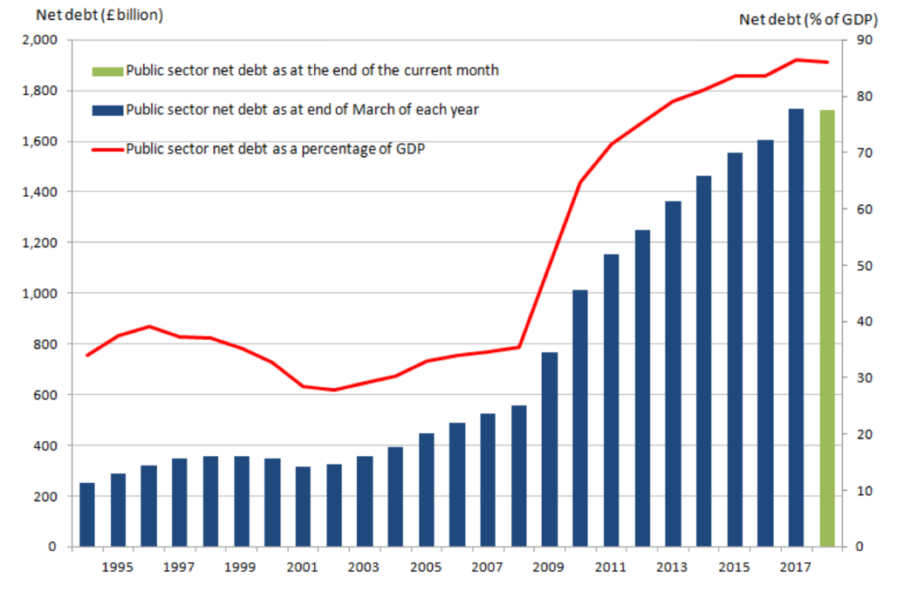
National Context – Why we are in this position
£1,785,300,000,000 (Sept 2017) – 87.2% GDP
Notes:
Problem Chancellor of the exchequer trying to fix
Stop the level of Government borrowing going up and contain it at its current level (to eliminate the structural deficit) not, at least in the first instance, to reduce the national overall indebtedness.
National net public sector debt stood at £1.8 trillion
More than twice the entire level of Government spending planned for 2015/16
Equivalent to 87.2% of the countries annual Gross Domestic Product (GDP).
Such debt levels can only be sustained through historically low interest rates
with Britain budgeting to spend around £36bn a year on debt interest in 2015/16 (3 times more than it will spend on local government).
Nov 2016 Chancellor set out a number of fiscal rules including
Public sector net debt as a share of GDP must be falling by 2020/21
Welfare speding must be within a cap by 2021/22

Slide 3
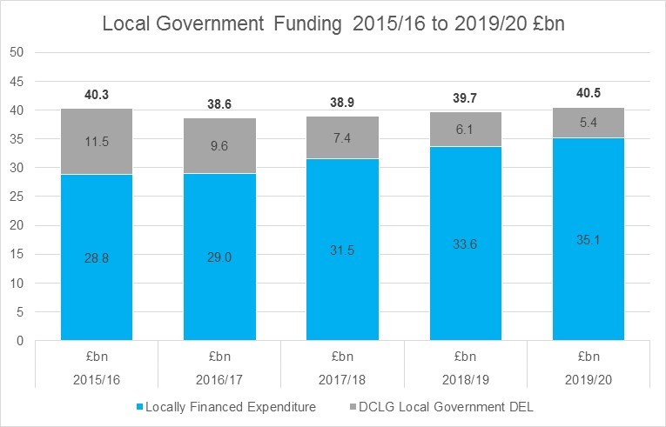
National Context – Why we are in this position
Governments strategic approach is to increase council tax as the mechanism for funding local services over the period to 2020.
Notes:
The first of which was 25 November 2015
Spending Review 2015 was issued by the then Chancellor George Osborne
The impact on Local Government was that the Department of Communities and Local Government’s: Departmental Expenditure Limit for Local Government was reduced from £11.5bn in 2015/16 to £5.4bn in 2019/20. This is a reduction of £6.1bn or - 53% and compares to reductions of;
- 31% Transport
- 11% Business, Innovation & Skills
- 10% Justice
and increases of;
+3% Home Office
+7% Education
+ 10% Defence
+ 11% Health
Assumes
Normal CTax Increase every year
Social care precept 2% every year
NHB and New better care fund merry-go-round
Capital Receipts used locally to pump prime invest to save initiatives
New Government – No indication this will change – advocates of Fiscal Prudence

Slide 4
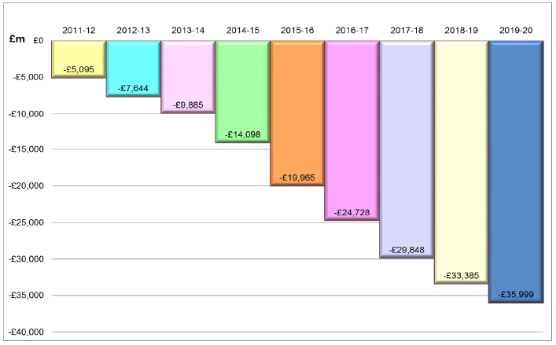
Local Context – Why we are in this position
Core Funding Reductions
Poole has accepted the 4 year funding offer from the Government in an attempt to cap these reductions.
Notes:
17 December 2015
was a day when the Government issued the indicative 4 year financial settlements.
As part of the this settlement the Government decided to move away from reducing their funding to Local Authorities by a uniformed percentage to a basis which took into account Council Tax yield. This approach hit Southern Upper Tier Authorities (be that Counties or Unitaries) particularly hard.
So welcome to a localised version of a graph which nationally is referred to as the graph of doom.
Important to highlight that the Council will receive no Revenue Support Grant after March 2019
Poole it is worse than that as the Government are intent in 2019/20 taking a further £1.4m from us by means of reducing our share of local business rates we are able to retain – with a redistribution to authorities of perceived higher need.

Slide 5
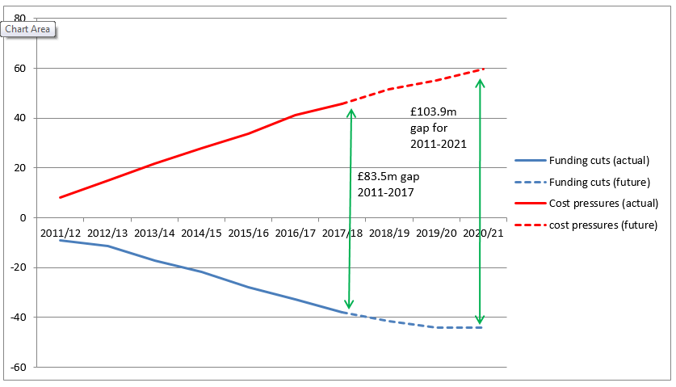
Local Context Impact of cost pressures and reductions in Government Funding
£20.4m to be found between 2018 and 2021
(£13.9m) already identified and assumed up to 2021 including Council Tax increases
£6.5m Annual Funding Gap still to find
Notes:
Funding reductions from Government only half the problem.
Brings me to a localised version of another national graph – this one referred to as the “Jaws of Death” – hence the reference at the start to a perfect storm
Pressuers
ASC – including the living wage
Pay Award
Pension costs
Price Inflation – waste disposal
Childrens Svs
Homelessness

Slide 6
Changing pattern of spend
Notes:
Issue leading on from growth pressures and our reaction to it and the Government funding reductions – is that it is changing the pattern of spend.

Slide 7
Changing pattern of funding
2013/14 2014/15 2015/16 2016/17 2019/20
Council tax
63%
£64.3m
65%
£65.2
68%
£66.3m
73%
£69.7m
84%
£85.0m
BR, tariff
15%
£15.2m
16%
£15.6m
16%
£15.8m
17%
£15.9m
16%
£15.9m
RSG
22%
£22.8m
19%
£19.3m
15%
£14.8m
10%
£9.9m
0%
£0.0m

Slide 8
The extent of the financial challenge
£2.9m Maintaining Parks
£1.8m Children’s Centres
£1.6m Libraries
£0.5m Museums
£0.4m Street lights
£0.1m Leisure Centres
£7.3m Total from these services
Notes:
Based on net revenue expenditure
£20.4m Reduction 2018 to 2021

Slide 9
The extent of the financial challenge
Impact on level of net expenditure or council tax requirement £000s
Sensitivity Analysis
Looked after child (high cost – residential)
Looked after child (medium cost – fostering)
Intensive homecare package for a disabled person
Vulnerable Adults (learning disability) <65 residential
Older person’s supported residential care
Increase in the £2.9m cost of the
concessionary fare scheme to the Council
278
17
99
76
35
£29k
per 1% increase
in journey numbers
Notes:
Sensitivities
2 LAC = Museum Service
1 LAC + 1 home care package disabled = Street Lighting
1 home care package disabled person = Leisure Centres

Slide 10
Financial Strategy
Short Term
Delivering a range of proposals which will generate positive
returns to the Council.
Investing in key Council priorities.
Encouraging and incentivising people into work.
Continuing to develop partnerships with other
Public Sector Bodies.
Redesigning services and driving out efficiencies.
Exploring a Digital Council approach.
Considering commercialisation of services where appropriate.
Considering levels of fees and charges.
Reviewing Council pay & cost of employment policies.
Some service reductions

Slide 11
Poole 2020 - Strategic Intent
Acting responsibly and preparing for the future by changing the way we work
Emphasise on the fact that we must live within our means
Aim by 2019/20 to present a budget not balanced by the use of the Financial Planning Reserve Earmarked Reserve
  2016/17 - £4.5m
  2017/18 - £0.8m
  2018/19 - £0 (eliminates the annual deficit)
more entrepreneurial, more efficient.
Notes:
Examples - - honing in on

Slide 12
Provisional 2018/19
Local Government Finance Settlement
Confirmed four year finance settlement 2016/17 to 2019/20
No further Government support Adult Social Care, Children's Social Care, Children's Services or to tackle Homelessness.
Announced intent to move to 75% Business Rates Retention System from 2020.
  Fiscally Neutral at a national level
  Underpinned principle of redistribution of resources based on need
  Will incorporate additional funding responsibilities including the Public Health Grant
  Subject to transitional measures
Recognised the impact of inflation was having on service delivery by increasing "core" council tax increase to 2.99%
Notes:
Examples - - honing in on

Slide 13
Council Tax
Only increased twice in the last 7 years since 2010
Frozen from 2011/12 to 2015/16 (inclusive)
Real term reduction of circa 10%
Poole has had the lowest Council Tax in Dorset for the last 17 years

Slide 14
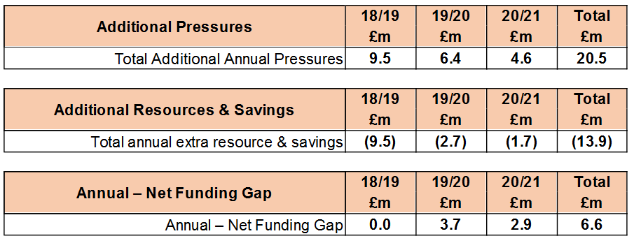
Budget 2018/19 & MTFP Summary
(January 2018)

Slide 15
2018/19 Financial Pressures
Key proposals include;
£3.8m Government Funding Reductions
£2.8m Vulnerable Adults
£0.3m Vulnerable Children
£0.4m Children's Services
£1.2m 2% Pay award
£1.0m Inflationary and other pressures
£9.5m Total
Includes the impact of the Living Wage

Slide 16
2018/19 Saving Proposals
Key proposals include;
£2.3m 3% Social Care Precept Council Tax Increase
£2.3m 2.99% basic core Council Tax increase
£1.1m Council Tax Taxbase increase, properties / LCTSS
£1.9m shared Corporate Services with Bournemouth
£0.1m shared Management & Operational costs SVPP & Bournemouth
(Revenue and Benefits Service)
£3.5m Service based efficiencies and additional resources
(£0.8m) Reduced drawdown Financial Planning Earmarked Reserve
(£0.6m) Adult Social Care Grant - one off in 2017/18
(£0.3m) Reduced New Homes Bonus Grant
£9.5m Total

Slide 17
Financial Outlook - Reserves
Unearmarked Reserves
To cover underlying operational risks of a business with turnover of £290m
£6.250m Balance 31/3/16
£6.250m Balance 31/3/17
Earmarked Reserves
Set aside to provide funding for specific programmes, initiatives or held to support various partnerships / 3rd Parties or held due to statue
£19.1m Balance 31/3/16
£14.7m Balance 31/3/17
£10.8m Balance 31/3/18 (December 2017 forecast)
Includes amounts being used to underpin the budget, reductions are in line with assumed use to support programme, risks etc. Grants held in reserves used to support purpose given
39% reduction between 31/3/15 & 31/3/17 (total reserves)

Slide 18
Q&As

